Slide 1
Exziton diffusion model
V 1.01 (DM1)

Slide 2
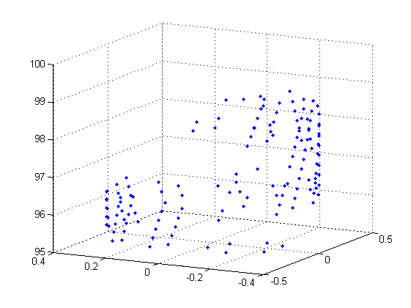
Program routine
3D random walk on nanotube lattice
Diffusion constant from (Hertel 2010): 10^(15) nm^2/s
Lifetime calculated by k_on/off values: T = 1/k*ln(1/r)
Routine:
Creates 2 initial conditions per exciton: Radiative and non-radiative emission by creating T_rad & T_nonrad
Smallest number wins (happens first)
In this time, the exciton diffuses randomly on the lattice
If it hits a defect (distance < 2 nm), two additional conditions appear: radiative & non-radiative defect emission
Same as before: calculates T_def_rad & T_def_nonrad, smallest wins
In the end: Counts numbers of different states happened

Slide 3
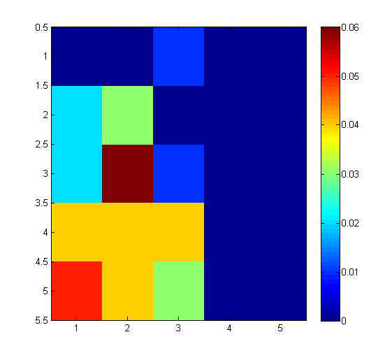
Readout
I_def_rad(k_rad, k_def_rad)

